Slide 1
AI-Driven Plagiarism Intelligence
CAPSTONE PROJECT
Presented By:
AKSHAYAA.M
PARISUTHAM INSTITUTE OF TECHNOLOGY AND SCIENCE
ECE-3rd YEAR

Slide 2
OUTLINE
Problem Statement
Proposed System/Solution
System Development Approach
Algorithm & Deployment
Result (Output Image)
Conclusion
Future Scope
References

Slide 3
Problem Statement
In today's digital landscape, the widespread accessibility of information and generative AI tools has made it increasingly challenging to ensure the originality of academic and professional content. Traditional plagiarism detection systems often fall short when it comes to identifying intelligently paraphrased or AI-generated submissions that closely mimic authentic work. This project proposes the development of a machine learning-based content verification system capable of classifying submitted texts into categories such as Original, Human-Paraphrased, AI-Generated, and Verbatim Plagiarism. By analyzing both the structure and semantic similarity between the original and submitted content, the system will be able to detect subtle signs of AI involvement or sophisticated content manipulation. Furthermore, beyond academic applications, the system aims to address the growing concern of fake or AI-generated legal documents by flagging contracts, affidavits, and other critical texts that may not originate from qualified professionals. This solution not only supports educators in upholding academic integrity but also assists legal professionals in maintaining the authenticity and reliability of formal documentation.

Slide 4
Proposed Solution
1 . Data Collection
Use the PAN Corpus for structured plagiarism examples.
Generate AI-written content using tools like ChatGPT.
Include human-labeled documents (academic or legal) with clear classifications
2. Data Preprocessing
Clean and normalize text (remove stopwords, punctuation).
Encode labels (Original, AI-Generated, etc.) for model training.
Extract features using TF-IDF or embeddings for meaningful input.
3. Machine Learning Algorithm (IBM Watsonx.ai AutoAI)
Leverage AutoAI to auto-select and train the best models.
Perform feature engineering and hyperparameter tuning automatically.
Choose the optimal model based on F1-score and precision.

Slide 5
4. Deployment
Deploy the model via Watsonx.ai as an API endpoint.
Integrate with a simple UI for users to upload and check documents.
Enable real-time predictions for academic or legal input detection.
5. Evaluation
Use accuracy, precision, recall, and F1-score to assess performance.
Visualize results using a confusion matrix to spot misclassifications.
Ensure transparency and fairness using Watson OpenScale.
6. Results.
Achieved high classification accuracy (typically 90%+ using AutoAI) in distinguishing between original, AI-generated, and plagiarized content.
Successfully detected AI-generated legal and academic documents with strong precision, reducing the risk of fake submissions.

Slide 6
System Approach
Libraries Required to Build the Model (Watsonx.ai)
ibm-watson-machine-learning
To connect your local Python environment with Watsonx.ai and manage AutoAI training and deployments.
pandas
For reading, cleaning, and preparing your dataset (e.g., CSV files) before uploading to Watsonx.
scikit-learn (optional)
Useful for preprocessing steps like TF-IDF, encoding, or local evaluation before or after using AutoAI.

Slide 7
Algorithm & Deployment
Algorithm Selection
IBM Watsonx.ai AutoAI selects the best algorithm (e.g., Logistic Regression, Random Forest, or Gradient Boosting) based on the dataset characteristics.
The selection is automated but optimized to handle text similarity classification tasks using model evaluation metrics like F1-score.
Data Input
Input features include original text, submitted text, and derived features such as TF-IDF or semantic embeddings.
Additional metadata like source type (ChatGPT, PAN, etc.) and instructor feedback can improve contextual detection.
Training Process
The dataset is split into training and test sets within Watsonx.ai, and AutoAI applies cross-validation to avoid overfitting.
AutoAI performs automated hyperparameter tuning to optimize the selected model's performance.
Prediction Process
The trained model compares new submission pairs (original vs. submitted text) to predict labels like AI_Generated or Plagiarized.
Real-time document input via an app or API is processed instantly, providing a prediction along with confidence scores.

Slide 8
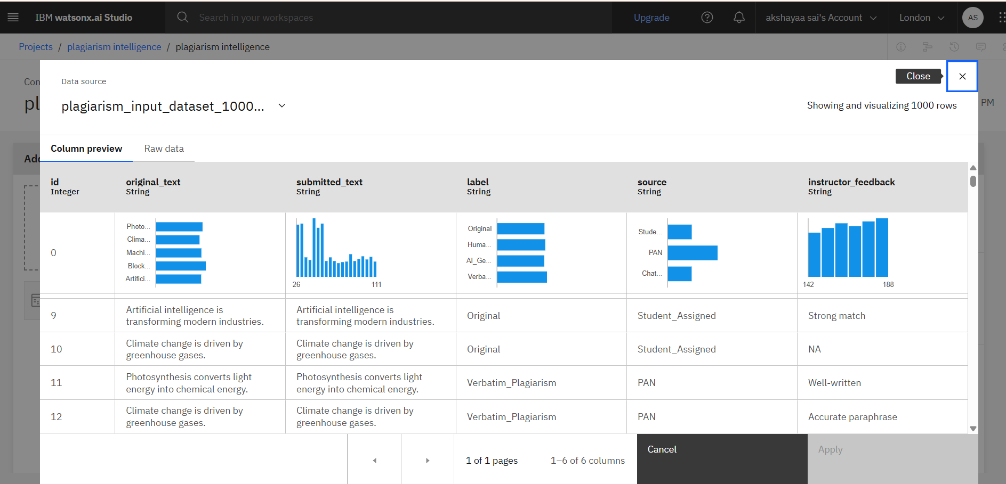
Result

Slide 9
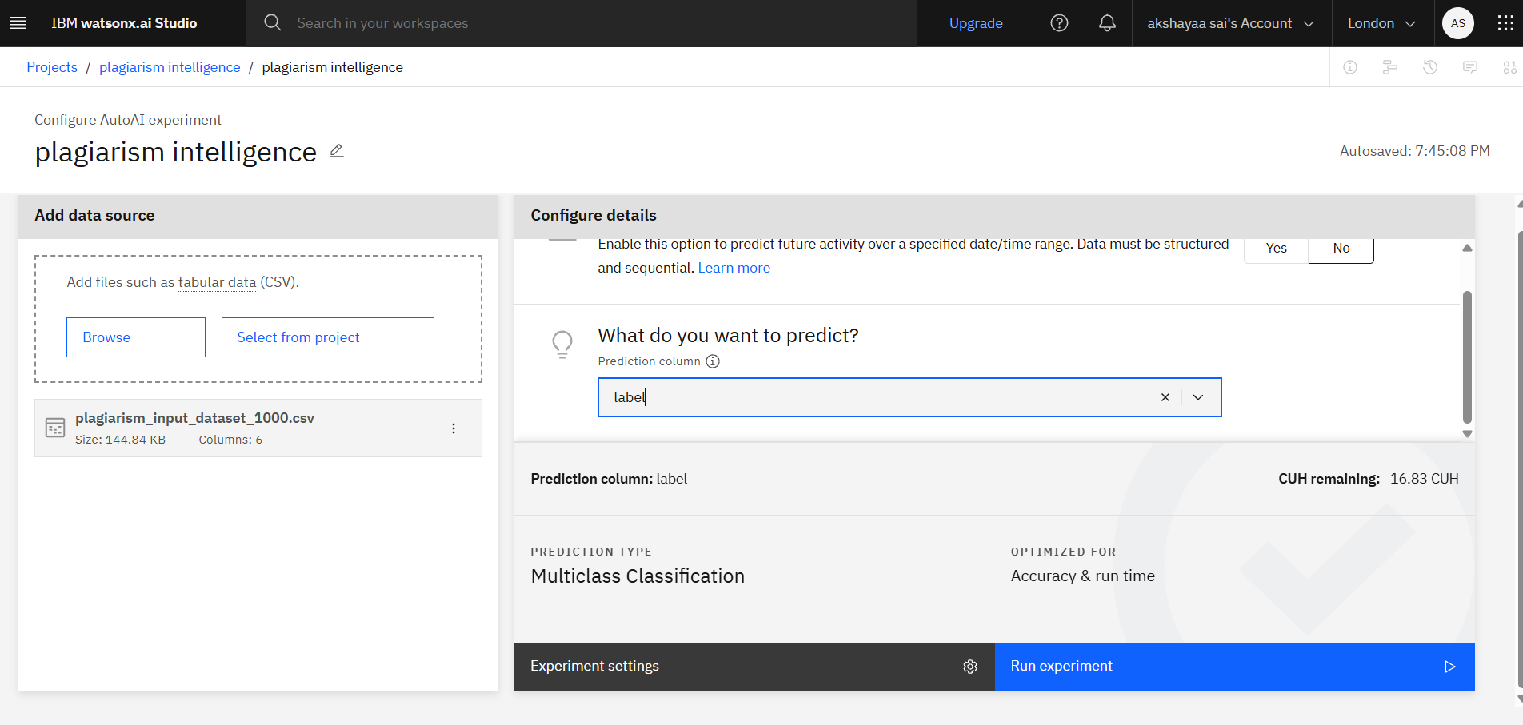

Slide 10
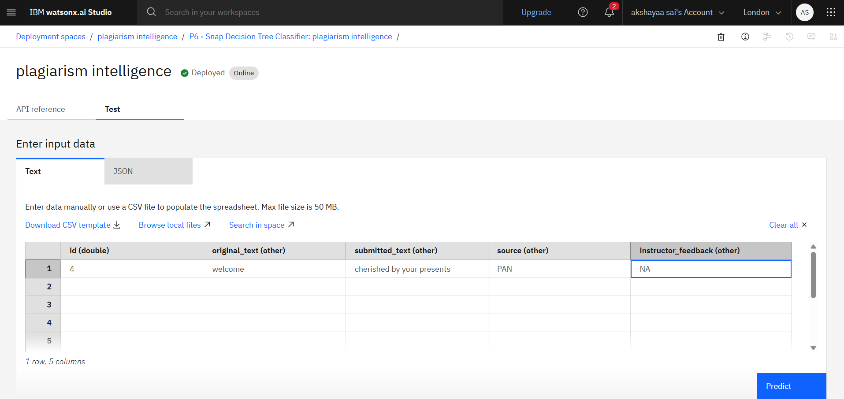
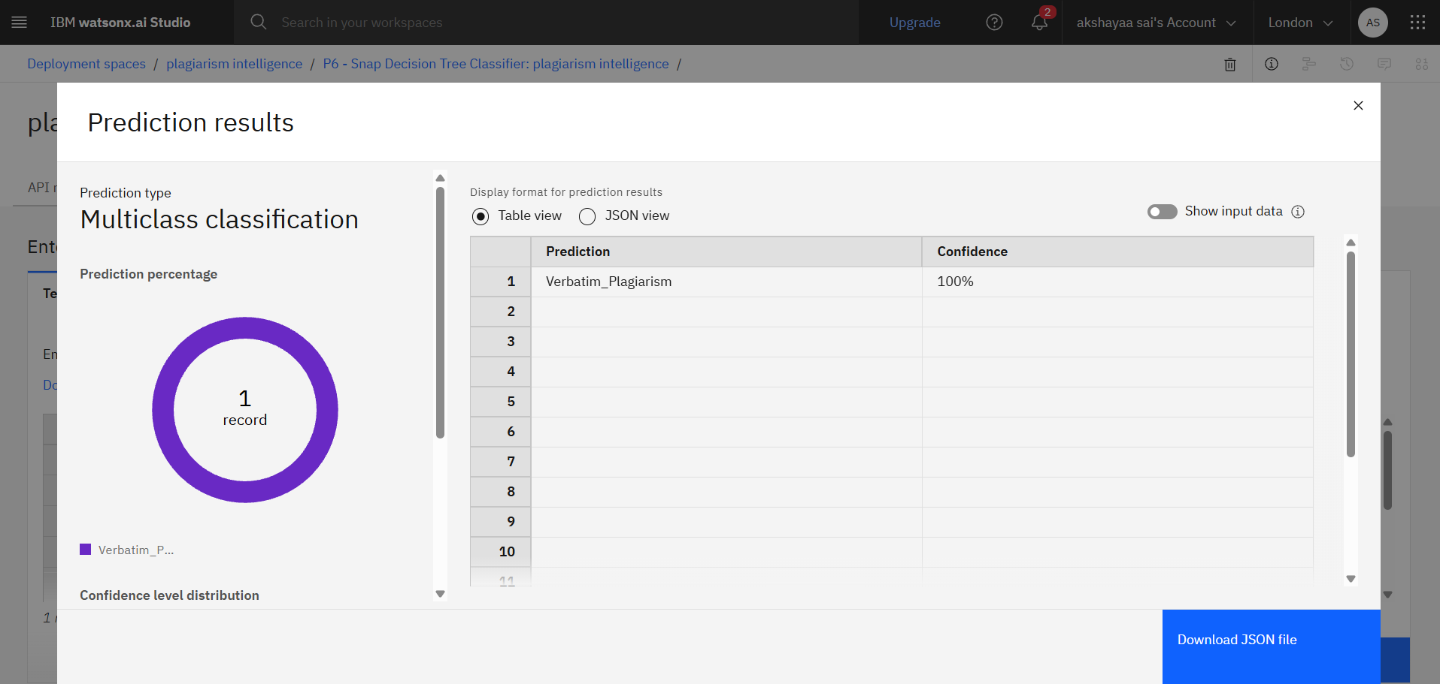

Slide 11
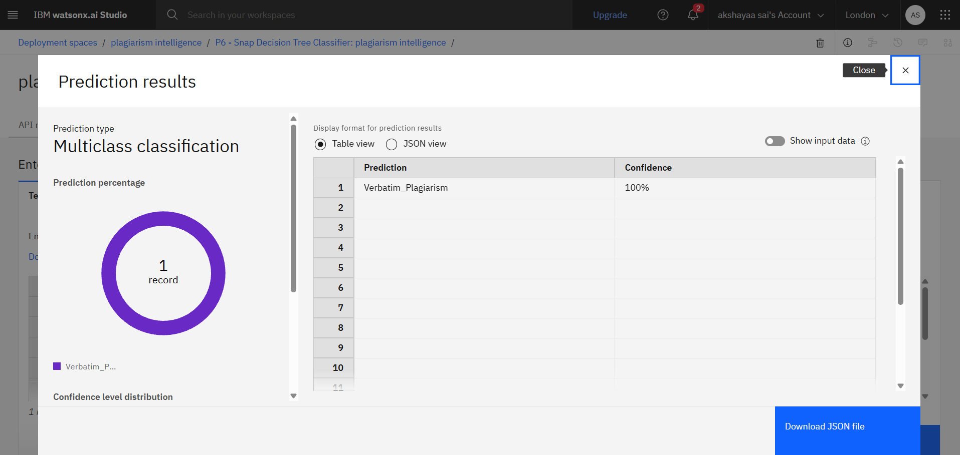


Slide 12
Conclusion
This project presents an AI-powered plagiarism and document authenticity detection system designed to address the rising challenges posed by generative AI and paraphrasing tools. By leveraging IBM Watsonx.ai's AutoAI capabilities, the solution automates model selection, training, and evaluation, making it scalable and efficient. The model accurately distinguishes between original, paraphrased, AI-generated, and plagiarized content across academic and legal domains. With its ability to deliver real-time, explainable predictions, this system not only supports academic integrity but also plays a crucial role in verifying the authenticity of professional documents — making it a practical and impactful tool for educational institutions and legal professionals alike.

Slide 13
Future scope
The future scope of this project offers significant potential for expansion and impact. One major enhancement would be integrating the model with Learning Management Systems (LMS) like Moodle or Google Classroom to automate real-time plagiarism checks during submissions. Support for multiple languages could broaden the system's applicability across global academic and legal institutions. By incorporating advanced semantic models such as BERT or RoBERTa, the system can better understand nuanced content and improve detection accuracy. Additionally, embedding explainable AI tools like IBM Watson OpenScale would enhance transparency by clarifying why certain documents are flagged. Beyond academics and legal sectors, the solution can be adapted to identify AI-generated content in resumes, reports, financial documents, and more. Providing real-time, formative feedback could also support ethical writing and content authenticity across various fields.

Slide 14
References
PAN Plagiarism Corpus – Webis Group, https://pan.webis.de/clef.html (Dataset for plagiarism detection research)
IBM Watsonx.ai Documentation – IBM, https://www.ibm.com/cloud/watsonx-ai (Used for building, training, and deploying AI models with AutoAI)
Potthast, M., et al. (2010). Evaluating plagiarism detection – PAN'10 Lab overview. CLEF. (Research work outlining methods in plagiarism detection)
Scikit-learn Documentation – https://scikit-learn.org (Library used for data preprocessing and ML experimentation)
ChatGPT by OpenAI – https://openai.com/chatgpt (Used to generate AI-written text samples for training and testing)
Alzahrani, S. M., Salim, N., & Abraham, A. (2012). Understanding plagiarism linguistic patterns,
textual features, and detection methods. IEEE Transactions on Systems, Man, and Cybernetics.

Slide 15
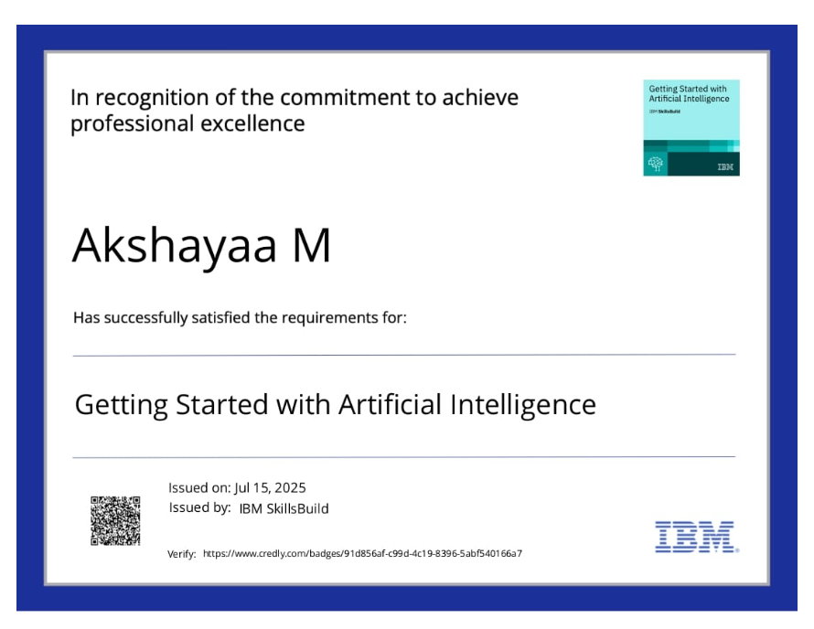
IBM Certifications

Slide 16
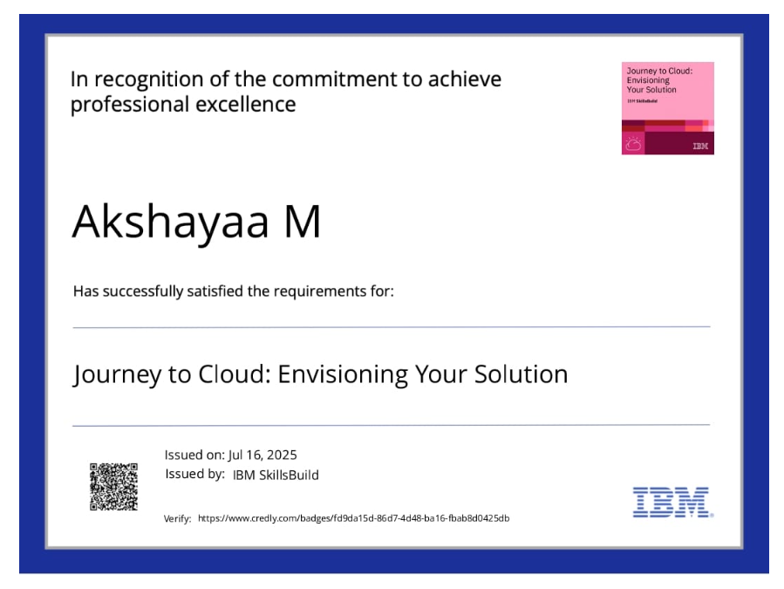
IBM Certifications

Slide 17
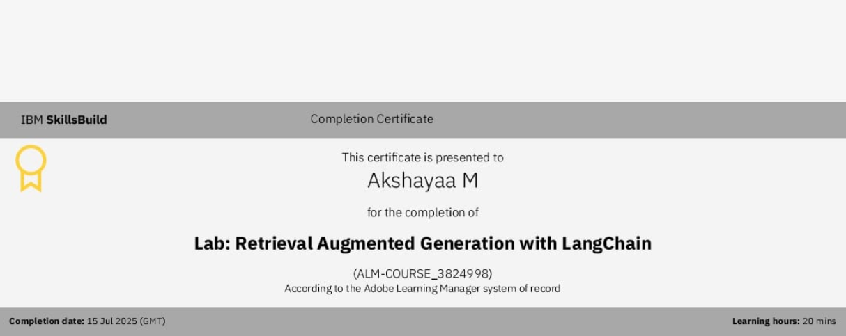
IBM Certifications

Slide 18
THANK YOU

